Slide 1
Lecture 7– Dynamic Programming – an optimization technique
Chiao-Ting Li
Postdoctoral Research Fellow
Department of Mechanical Engineering, University of Michigan

Slide 2
Outline
Bellman’s principle of optimality
Toy example 1: the Shortest path problem
Toy example 2: SISO system
A realistic example: Prius 2010

Slide 3
Dynamic Programming (DP)
The DP technique is based on the Bellman’s principle of optimality—“An optimal policy has the property that, whatever the initial state and optimal first decision may be, the remaining decisions constitute an optimal policy with regard to the state resulting from the first decision”*
DP is a recursive method for finding the optimal trajectory over a fixed horizon
DP solves the problem backwards in time, i.e., the solution starts when there is only one stage left in the decision process, and then move backwards recursively
*R. E. Bellman, Dynamic Programming. New Jersey: Princeton University Press, 1957.

Slide 4
Shortest Path Problem
2
5
5
4
6
5
2
1
1
3
3
2
6
3
8
3
4
2
4
4
4
1
7
Stage 0
Stage 1
Stage 2
Stage 3
Goal: To find the shortest path from Node 1 to Node 8

Slide 5
Shortest Path Problem
2
5
5
4
6
5
2
1
1
3
3
2
6
3
8
3
4
Stage 0
2
4
Stage 3
4
4
1
7
Stage 1
Stage 2
f_{i} = shortest path from Node i to the end
t_{ij} = transitional cost from Node i to Node j
We will solve f_{i} from the last stage
E. V. Denardo, Dynamic Programming: Models and Applications. New York: Prentice-Hall, 1982.

Slide 6
Shortest Path Problem
Stage 3: (state from the end)
2
5
5
4
6
5
2
Stage 2:
1
3
1
6
8
3
2
3
4
3
Stage 0
2
4
Stage 3
4
4
7
1
Stage 1:
Stage 1
Stage 2
Stage 0:
The shortest path: 1 → 3 → 6→ 8
The shortest path length: 8

Slide 7
Important Facts
To solve the overall optimization problem (from Node 1 to Node 8), we solved all the sub-problems (from all nodes to the terminal node)
Hence, DP is computationally expensive
DP problem was solved backwards in time
Principle of Optimality!!

Slide 8
Dynamic Programming Algorithm
The original optimization problem
Minimize the cost function
Transitional Cost
Terminal Cost
Subject to
System Dynamics
State Constraints
Control Constraints
A Sequence of Simpler Problems
Step N:
Terminal Cost
Step k, for 0 ≤ k < N:
Cost-to-Go Function
Found via interpolation

Slide 9
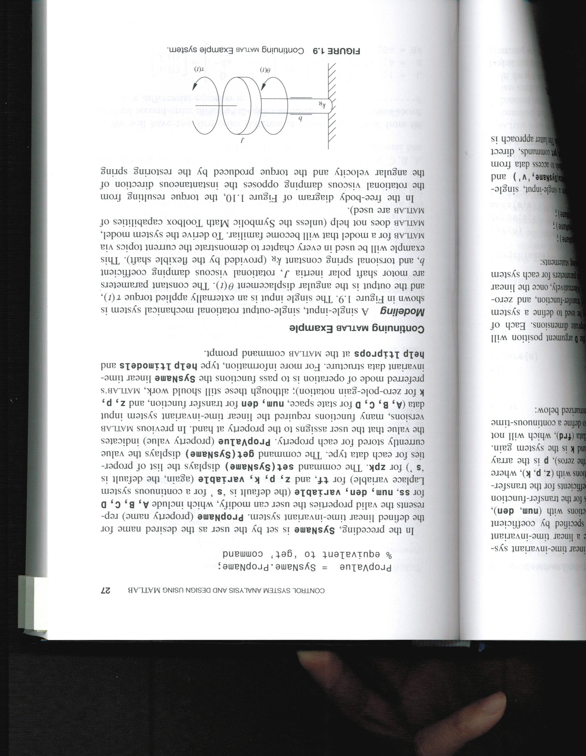
Single-Input, Single-Output Rotational Mechanical System
Input: external torque τ(t)
Output: angular displacement θ(t)
System Dynamics:
Parameters:
shaft inertia J
damping coefficient b
torsional spring constant k_{R}
State-Space Description:
R. L. Williams and D. A. Lawrence, Linear state-space control systems: John Wiley & Sons, 2007.

Slide 10
State Feedback Controller Design
%% open-loop state-space realization
%% two states: x1: theta, x2: theta dot
J = 1; b = 4; kR = 40;
A = [0 1;
-kR/J -b/J];
B = [0;
1/J];
C = [1 0];
D = 0;
Pole Placement
LQR Design
%% desired closed-loop dynamics
PO = 3; % overshoot percentage
ts = 0.7; % settling time [sec]
term = pi^2 + log(PO/100)^2;
zeta = log(PO/100)/sqrt(term); % damping ratio
wn = 4/(zeta*ts); % natural frequency
%% generic second-order frequency
num2 = wn^2; % numerator
den2 = [1 2*zeta*wn wn^2]; % denominator
CL_sys_pole = roots(den2); % desired eigenvalues
%% pole placement
K = place(A,B,CL_sys_pole)
%% LQR design
Q = 20*eye(2);
R = 1;
KLQR = lqr(A,B,Q,R)
K =
18.8627 7.4286
KLQR =
0.2492 2.0414

Slide 11
Dynamic Programming
Use DP to solve the following problem:
with
and
%% discrete-time system
[Ad, Bd] = c2d(A, B, Ts);
Demonstrate how to implement DP numerically
Calculate the cost-to-go function via interpolation
Compare DP solution with LQR solution to showcase that DP does produce optimal solutions

Slide 12
Dynamic Programming Implementation
Quantize state values into finite grids:
x1_grid = -1:0.5:1;
x2_grid = -1:0.5:1;
(0,1)
(1,0)
(-1,0)
(0,-1)
(These are only examples. They are too coarse to be used in real implementation)

Slide 13
Dynamic Programming Implementation
Two particular time steps:
k = N-1
k = N

Slide 14
Dynamic Programming Implementation
k = N-1
Step N:
k = N
Calculate the terminal cost

Slide 15
Dynamic Programming Implementation
Step N-1:
k = N-1
k = N
u_grid = -1:0.2:3;
Quantize control values into finite grids
x_{k} = (0,0)
u_{k} = 0
x_{k+1} = (0,0)
Calculate the cost-to-go function

Slide 16
Dynamic Programming Implementation
Step N-1:
k = N-1
k = N
u_grid = -1:0.2:3;
Another control value:
x_{k+1} = (0,0.4)
u_{k} = 0.4
x_{k} = (0,0)
Calculate the cost-to-go function
In general, x_{k+1} will not land “on the grid”
Therefore, interpolation is needed to find
Found via interpolation (MATLAB command: interp2)

Slide 17
Dynamic Programming Implementation
Step N-1:
k = N-1
k = N
u_grid = -1:0.2:3;
x_{k} = (0,0)
Cost-to-go is found by searching through all possible control values

Slide 18
Dynamic Programming Implementation
Step N-1:
k = N-1
x1_grid = -1:0.5:1;
k = N
x2_grid = -1:0.5:1;
u_grid = -1:0.2:3;
x_{k} = (0.5,0)
Cost-to-go function is calculated for all state grids at Step N-1

Slide 19
Dynamic Programming Algorithm
State and control values are quantized into finite grids
Solve recursive equation backwards in time
Step N:
Step k, for 0 ≤ k < N:
Obtain an optimal, time-varying, state-feedback control policy
→ Stored in a table for each of the quantized states and time stages
DP creates a family of optimal paths for all possible initial conditions

Slide 20
MATLAB Script
Ts = 0.05; % sampling time [sec]
n = 0:1:(4/Ts);
N = length(n);
x1_grid = -0.2:0.025:0.425;
x2_grid = -2:0.1:1;
u_grid = -1:0.2:3; % [1]x[21] vector
%% ==============================
%% step 1: transitional cost
L_table = zeros(length(x1_grid), length(x2_grid), length(u_grid), N);
x1n_table = zeros(length(x1_grid), length(x2_grid), length(u_grid), N);
x2n_table = zeros(length(x1_grid), length(x2_grid), length(u_grid), N);
for k = 1:N % loop for time
for i = 1:length(x1_grid) % loop for x1
x1 = x1_grid(i);
for j = 1:length(x2_grid) % loop for x2
x2 = x2_grid(j);
xn = repmat(Ad*[x1;x2],1,length(u_grid)) + Bd*u_grid;
x1n_table(i,j,:,k) = xn(1,:);
x2n_table(i,j,:,k) = xn(2,:);
L_table(i,j,:,k) = [x1;x2]'*Q*[x1;x2] + R*u_grid.^2;
end % end of loop for x2
end % end of loop for x1
end % end of loop for time
%% ==============================
%% step 2: cost-to-go
J_star = zeros(length(x1_grid), length(x2_grid), N);
u_opt = zeros(length(x1_grid), length(x2_grid), N);
k = N;
[X2,X1] = meshgrid(x2_grid, x1_grid);
J_star(:,:,k) = Q(1,1)*X1.^2 + Q(2,2)*X2.^2; % terminal cost
for k = N-1:-1:1 % backward loop for time
for i = 1:length(x1_grid) % loop for x1
for j = 1:length(x2_grid) % loop for x2
x1n = squeeze(x1n_table(i,j,:,k));
x2n = squeeze(x2n_table(i,j,:,k));
x1n(x1n>max(x1_grid)) = max(x1_grid);
x1n(x1n<min(x1_grid)) = min(x1_grid);
x2n(x2n>max(x2_grid)) = max(x2_grid);
x2n(x2n<min(x2_grid)) = min(x2_grid);
J_temp = squeeze(L_table(i,j,:,k)) + ...
interp2(x2_grid, x1_grid, J_star(:,:,k+1), x2n, x1n);
[opt_value, opt_id] = min(J_temp);
J_star(i,j,k) = opt_value;
u_opt(i,j,k) = u_grid(opt_id);
end
end
end
Parallelization (calculate x_{k+1} with all possible u at once)
Element-wise manipulation
%% ==============================
%% step 3: retrieve optimal solution
u_sim = zeros(1, N);
x1_sim = zeros(1, N);
x2_sim = zeros(1, N);
x0 = [0.4;
0.2];
x1_sim(1) = x0(1);
x2_sim(1) = x0(2);
for k = 1:N-1
u_sim(k) = interp2(x2_grid, x1_grid, u_opt(:,:,k), x2_sim(k), x1_sim(k));
xn = Ad*[x1_sim(k);x2_sim(k)] + Bd*u_sim(k);
x1_sim(k+1) = xn(1);
x2_sim(k+1) = xn(2);
end
Find via interpolation
Notes:
85 lines in total

Slide 21
The Optimal Solution
Zoom In

Slide 22
Computation Time
Pole Placement | LQR | Discrete LQR | Dynamic Programming
0.061 | 0.12 | 0.063 | 56.21
* Time in seconds

Slide 23
Comments
DP is not (typically) real-time implementable
computationally expensive; the “curse of dimensionality”
needs future information, so that the problem can be solved backward in time
However, DP can
handle non-linearity, constraints, discontinuity
guarantee global optimality over a horizon
provide benchmarking performance

Slide 24
HEV Problem Formulation
Control Inputs
T_{e}: engine torque
T_{m}: motor torque
State variables
ω_{e}: engine speed
SOC: battery state of charge
Discrete-time nonlinear system
Constraints
Minimize the cost function

Slide 25
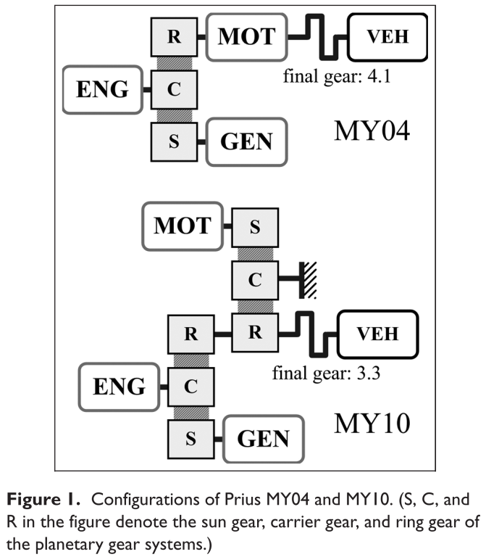
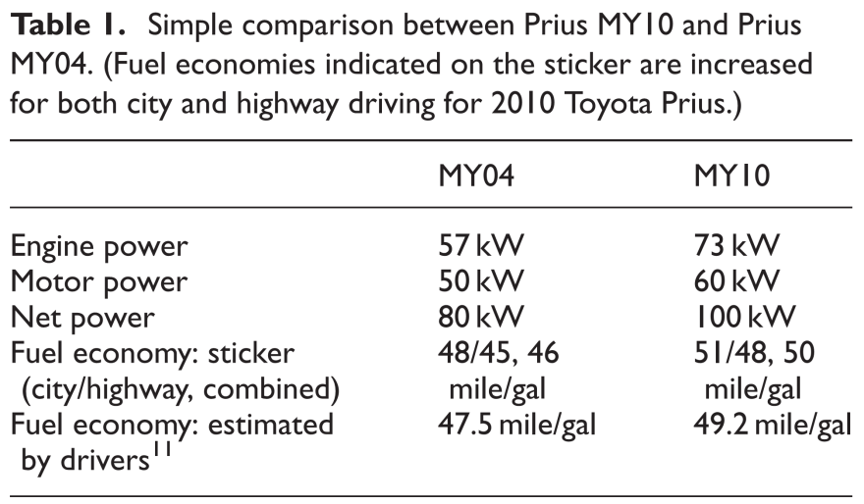
Prius 2010
* N. Kim, A. Rousseau and E. Rask, "Vehicle-level control analysis of 2010 Toyota Prius based on test data," Proceedings of the Institution of Mechanical Engineers, Part D: Journal of Automobile Engineering, vol. 226, pp. 1483-1494, 2012.

Slide 26
Prius 2010
Goal: To optimize fuel consumption over a predefined driving cycle

Slide 27
Prius 2010
Goal: To optimize fuel consumption over a predefined driving cycle
The assumption to simplify the problem:
Original Problem
Simplified Problem
Controls:
Assumption:
u₁: engine torque
u₂: MG1 torque
Engine operates along the optimal BSFC line
States:
Control:
x₁: engine speed
x₂: battery state of charge
u: MG1 torque
States:
x₁: engine speed
x₂: battery state of charge
Problem dimension: 4
Problem dimension: 3

Slide 28
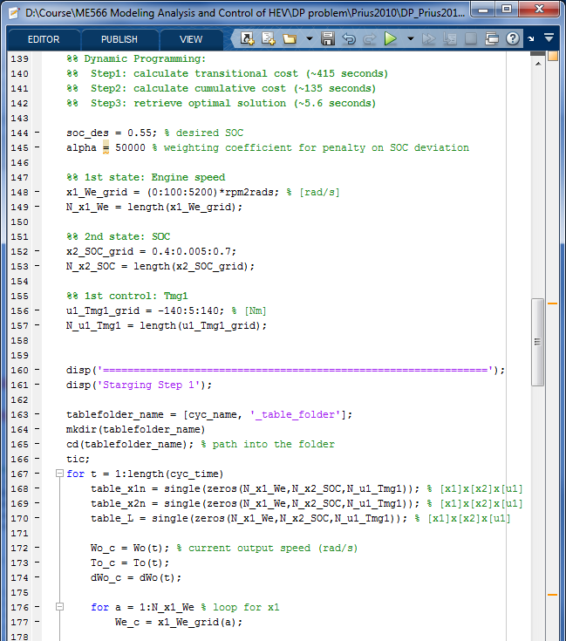
MATLAB Script
Step 1: calculate transitional cost L(x_{k},u_{k})
Step 2: calculate cost-to-go function
Step 3: retrieve optimal control & solution trajectories

Slide 29
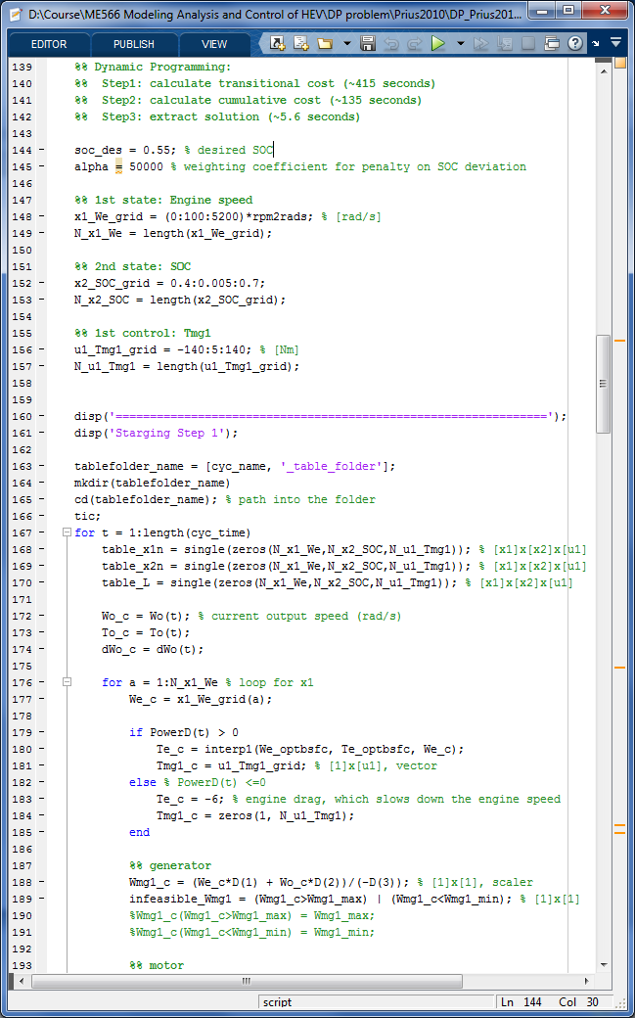
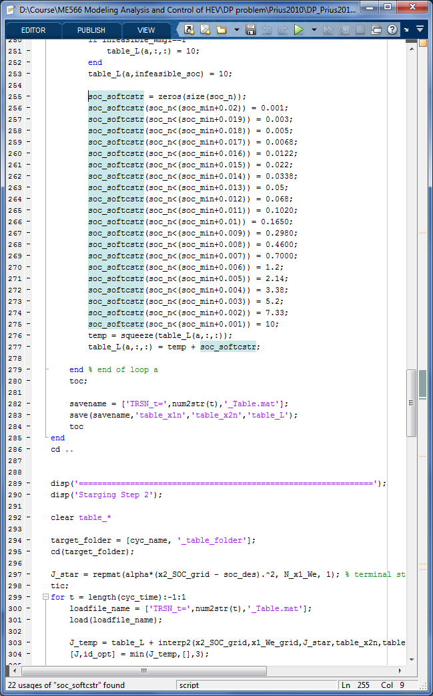
Numerical Treatment to Enforce Constraints
Hard constraints
the no-brainer way: apply Inf to grids that have constraint violation
However, MATLAB cannot perform interpolation on tables with Inf or nan
Soft constraints
the batter way: apply finite but sufficiently high penalty on x₂ (battery SOC) to prevent over discharge

Slide 30
Truncated NEDC Cycle
Different SOC initial conditions
Engine is used less often
(Engine is never used if the SOC starts above 0.48)

Slide 31
Truncated NEDC Cycle
More expensive penalty on final SOC (larger α)
Batter SOC regulation

Slide 32
Full NEDC Cycle
Different SOC initial conditions

Slide 33
Fuel Economy
The fuel consumption needs to be corrected to rule out the SOC effect, so that the fuel economy can be compared fairly
Use cftool in MATLAB or “Add Trendline” in Excel to perform a linear curve fit

Slide 34
Fuel Economy in Different Driving Cycles

Slide 35
Homework
A toy HEV problem:
with discrete-time dynamics:
where
x_{k} is the state at time k (SOC),
u_{k} is the control signal at time k (engine power),
w_{k} is the disturbance signal at time k (power demand)
N is the problem horizon,
The driving cycle is assumed to be know and has the following power demand profile:
(The coarse grids are selected so that the optimization problem can be solved manually)

Slide 36
Homework
Goal: find optimal control policy to minimize the cost function
Use the following values:

Slide 37
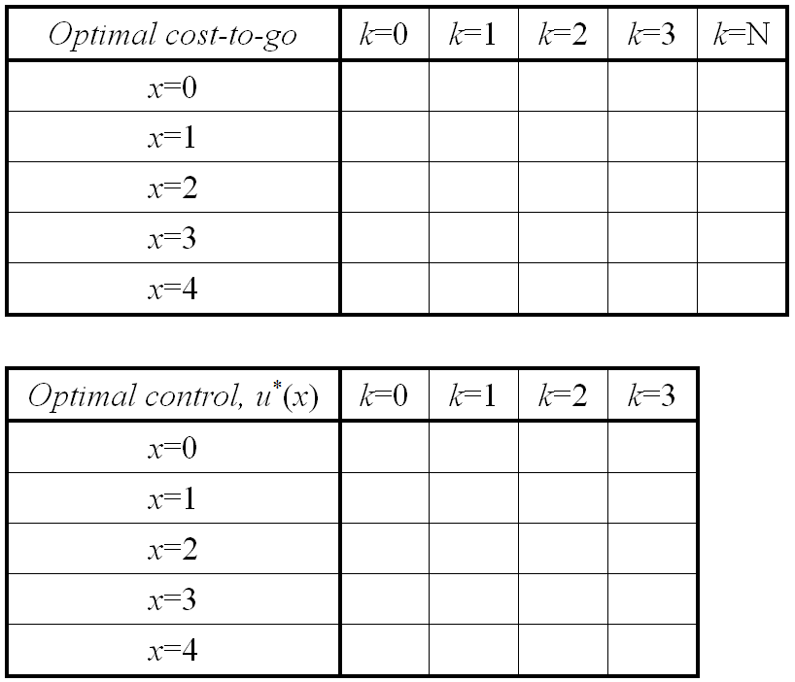
Homework
Step N:
Step k, for 0 ≤ k < N:

